Slide 1
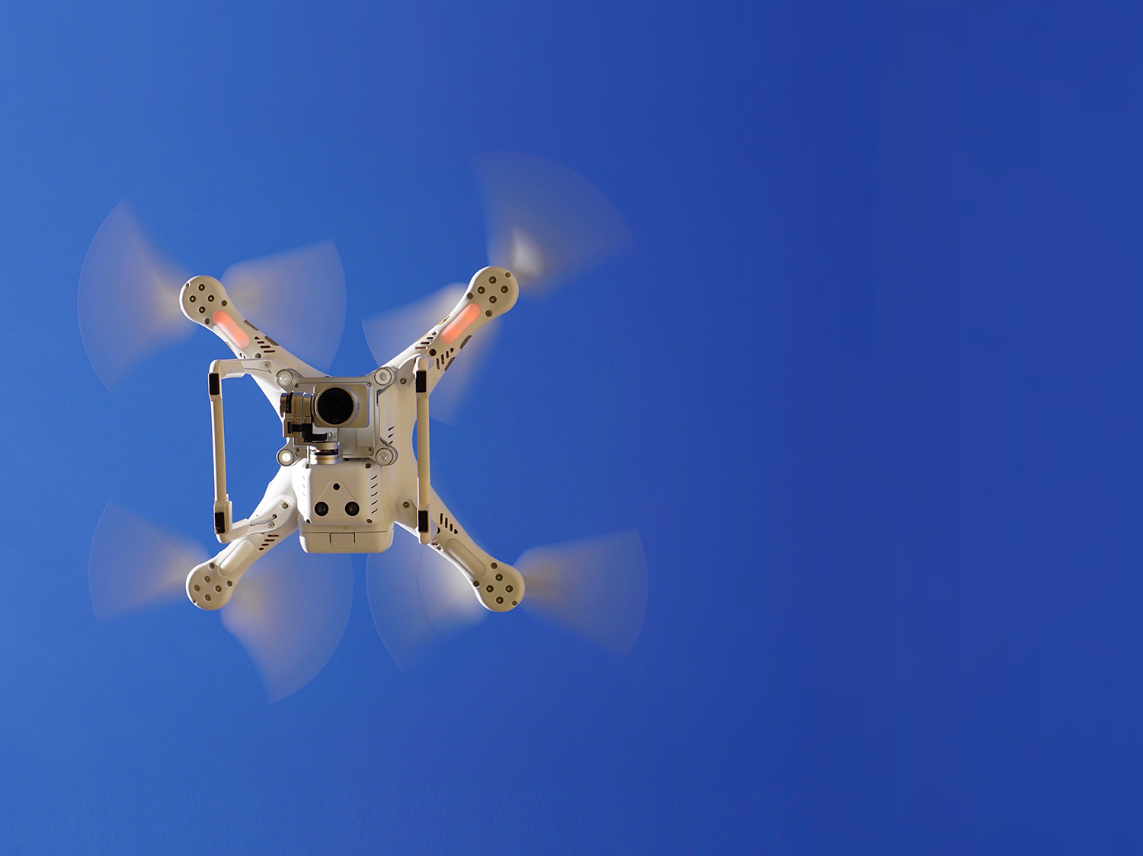

Emergency Ambulance Drone
Team Transformers
-Darshak Shah
-Devarsh Shah
-Sreevatsan Sreekanth
-Vinod Thiagrajan

Slide 2
Abstract
The project focuses on providing a temporary relief to people who get a sudden cardiac arrest where the medical team may take some time to reach and at times the patient faints.
All the people who are enrolled with this technology will be having a wrist wearable smart device(fitbit) that gives a real time update of their heart rates.
With that their basic medical data will be recorded and stored in the system at the base station.
As soon as there is a fluctuation in their real time heart rate, the base station will go through a number of checks to know whether there is some medical emergency or not and as soon as it confirms a drone will be sent to the patients location.
The drone calculating the shortest path and time will reach the patient and give him temporary relief preventing him to faint till the medical team arrives.

Slide 3

Motivation behind the project
Each year nearly a million people suffer from a cardiac arrest. A mere 8% survives due to slow response times of emergency services.
The ambulance-drone is capable of saving lives with an integrated defibrillator. The goal is to improve existing emergency infrastructure with a network of drones.
This new type of drones can go over 35mph and reaches its destination within 3-5 minutes, which increases chance of survival from 8% to 80%.

Slide 4
Existing Solution
What exist currently : https://youtu.be/y-rEI4bezWc
Flaws of the existing solution:
Once a person gets a cardiac arrest, someone needs to call the drone for his rescue, which is very much similar calling to the hospital in case of emergency.
The drone reaches the patient only after he or she is fainted.
No proper traversal system and collision avoidance for the drone.
The technology only exists in urban areas.

Slide 5
Proposed Solution
Medical research suggest that whenever a person is going to get a cardiac arrest, the heart rate fluctuation starts around 30-45 minutes before the attack.
Since we will be getting the real time updates of the persons heart rate, the drones will be sent 30 minutes before the patient is going to get a heart attack, which increases the chances of the person to be saved.
No one needs to call for the emergency, the data will automatically show when the person needs help.
Emergency contact people will automatically be notified.
A proper algorithm for the shortest traversal path and time.
Introduction of this technology even to the rural and remote areas.

Slide 6
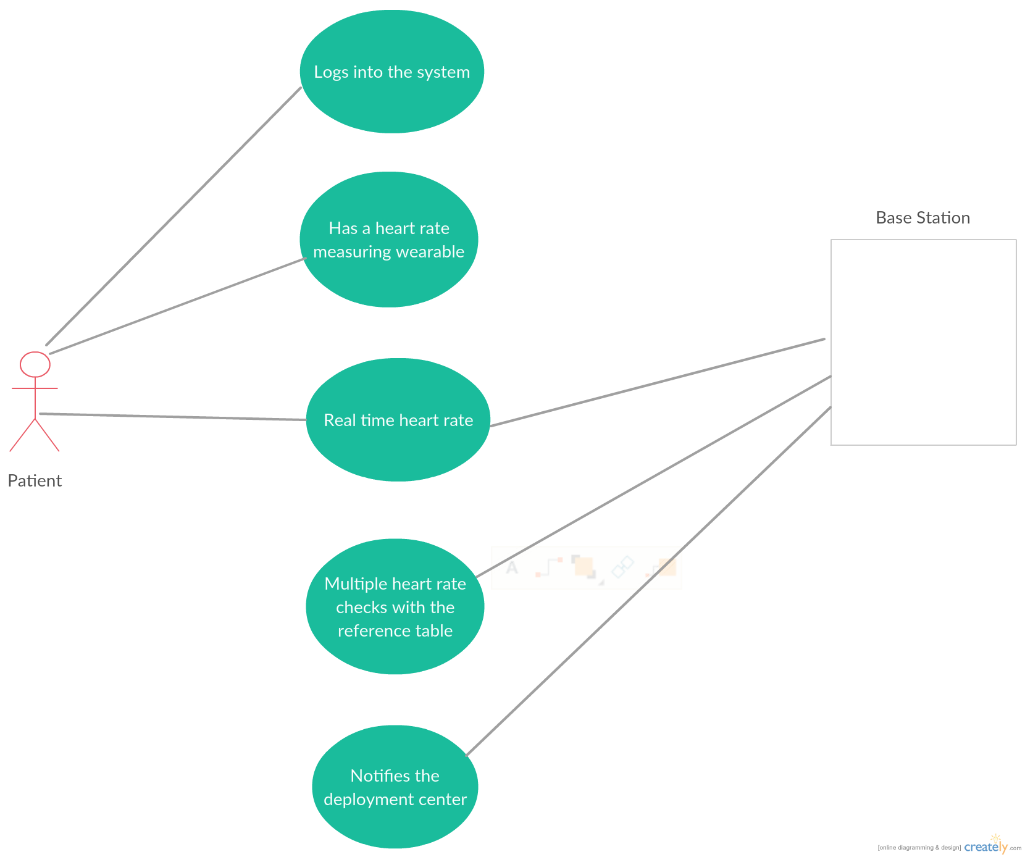
Use Case Diagrams

Slide 7
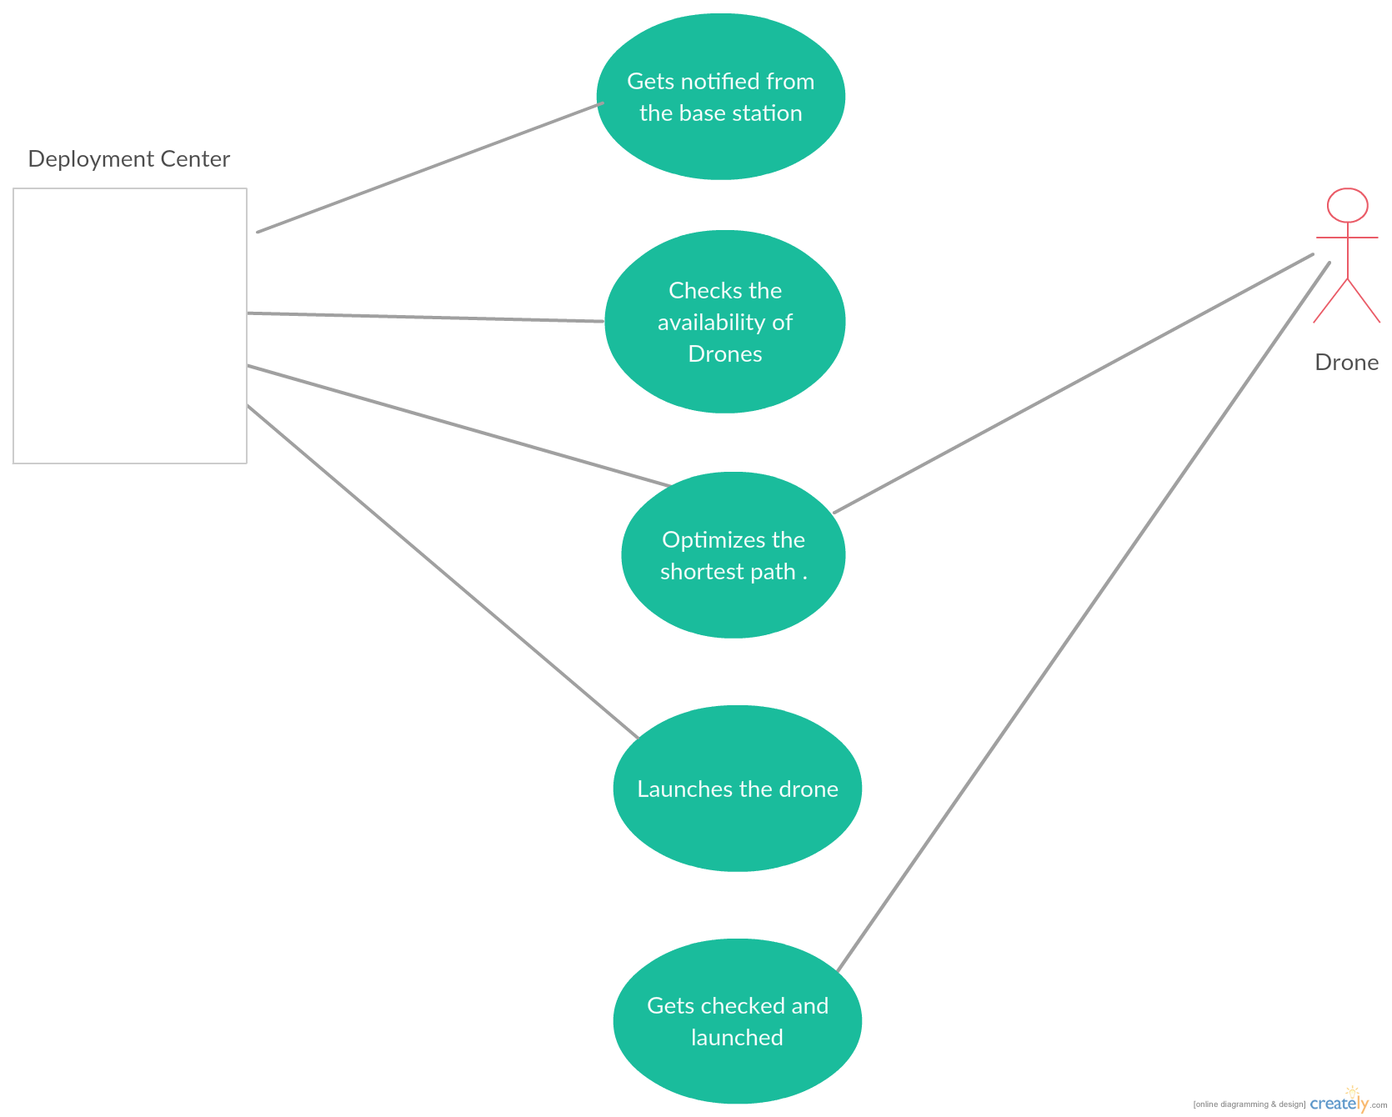
Use Case Diagrams(continued)

Slide 8
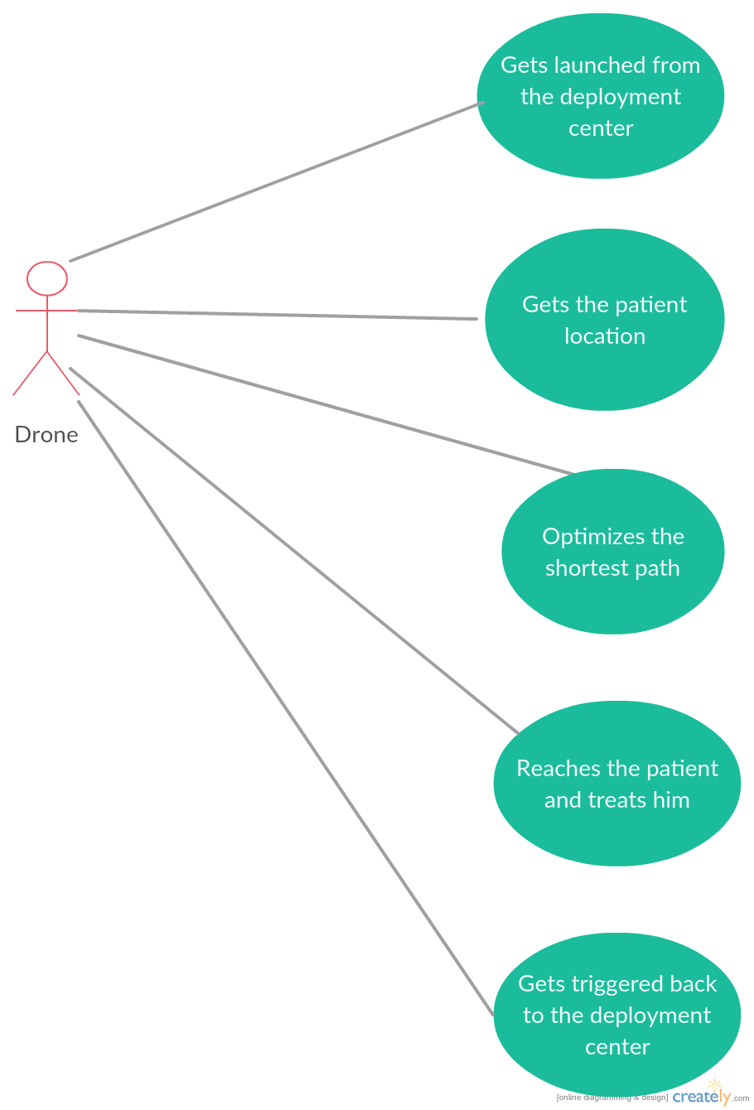
Use Case Diagrams(continued)

Slide 9
Algorithms

Slide 10
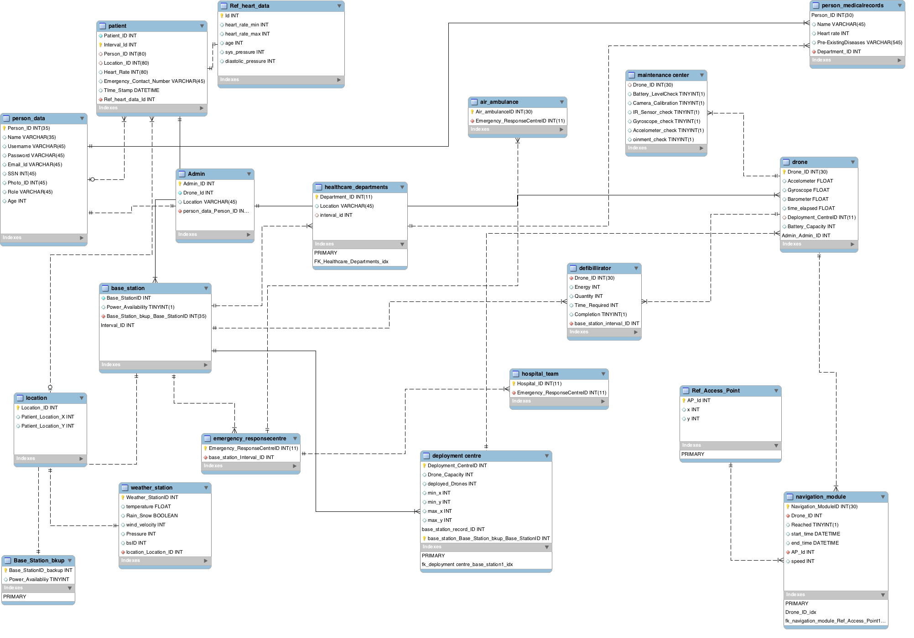
ERD

Slide 11
Joins

Slide 12
Functions

Slide 13
Triggers

Slide 14
Stored Procedures

Slide 15
UI/Views

Slide 16
Future Scope
With the technological innovations and artificial intelligence in the future there can be automatic robotic drones that will not require human assistance for treating a patient.
The field can be expanded to treat other medical issues such a diabetes, respiratory problems, traumas etc.
With more powerful drones in the future many people can be saved from natural calamities like flood, fire and earthquakes.

Slide 17
Conclusion and References
Emergency Ambulance Drone is an integration of technology, database and medical science.
Temporary reviving the heart rate patients in emergency situations and increasing the patient saving rate from 8% to 80%.
Fastest air ambulance drone with shortest traversal time and collision avoidance, reaching the patient before he or she faints.
Also providing the service in rural and remote areas.

